Slide 1
TOPIC: MATRICES (PART B)

Slide 2
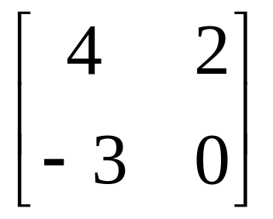
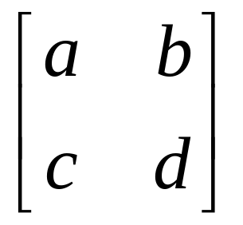
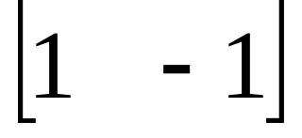
MATRICES - INTRODUCTION
Matrix algebra has at least two advantages:
Reduces complicated systems of equations to simple expressions
Adaptable to systematic method of mathematical treatment and well suited to computers
Definition:
A matrix is a set or group of numbers arranged in a square or rectangular array enclosed by two brackets

Slide 3
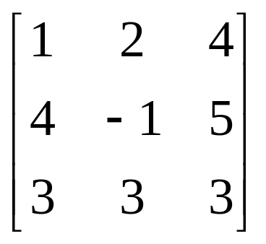
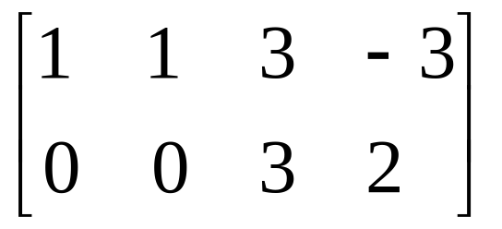
Properties:
A specified number of rows and a specified number of columns
Two numbers (rows x columns) describe the dimensions or size of the matrix.
Examples:
3x3 matrix
2x4 matrix
1x2 matrix

Slide 4
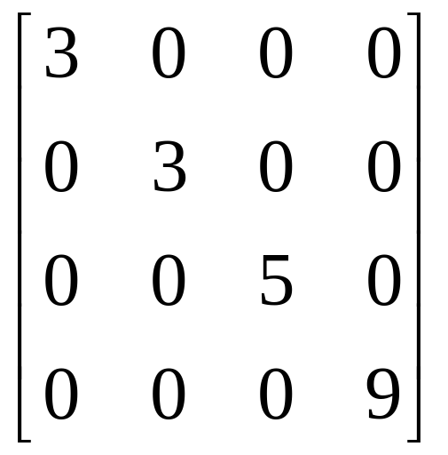
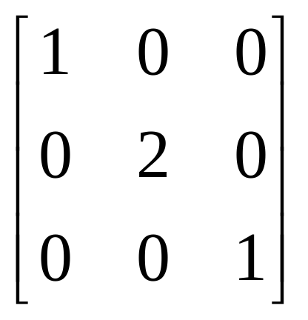
TYPES OF MATRICES
1. Diagonal matrix
A square matrix where all the elements are zero except those on the main diagonal

Slide 5
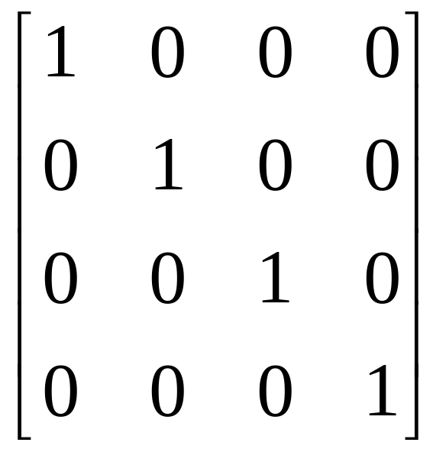
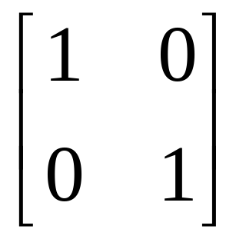
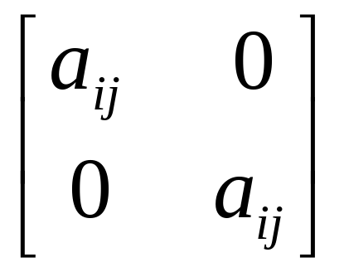
TYPES OF MATRICES
2. Identity matrix
A diagonal matrix with ones on the main diagonal

Slide 6
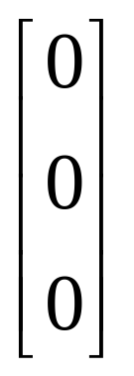
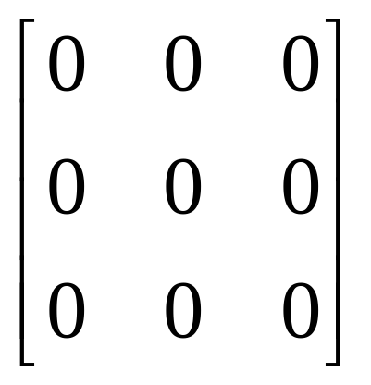
TYPES OF MATRICES
3. Null (zero) matrix - 0
All elements in the matrix are zero

Slide 7
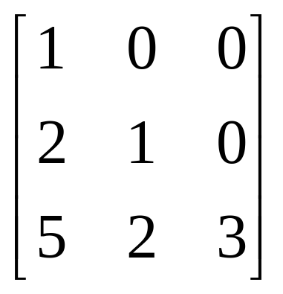
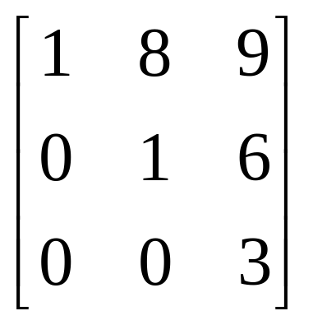
TYPES OF MATRICES
4. Triangular matrix
A square matrix whose elements above or below the main diagonal are all zero

Slide 8

TYPES OF MATRICES
5. Diagonally Dominant matrix
a square matrix is said to be diagonally dominant if, for every row of the matrix, the magnitude of the diagonal entry in a row is larger than or equal to the sum of the magnitudes of all the other entries in that row.

